Slide 1
Casa Azul Supply Co.
SALES DATA · SQL & POWER BI ANALYTICS · 2014–2017
Notes:
PRESENTER 1 starts here. Introduce the team and the project: ten SQL questions first, then the Power BI dashboard.

Slide 2
This presentation will be given to you by Group Four
Mohamed Taha
Mayada Salama
Mohamed Sameh
Habiba Fawzy
Esraa Mohamed
Abdullah Mekky
Notes:
PRESENTER 1 starts here. Introduce the team and the project: ten SQL questions first, then the Power BI dashboard.

Slide 3
Let’s Zoom Out and See What’s Ahead
The business
The decisions
Casa Azul Supply Co. is the store identity used in this project, built on a retail sales dataset of furniture, office supplies and technology orders, the store sold $2.3M in four years but kept only $286K as profit, and 299 of its 1,850 products lose money. Where is the money made, and where does it leak?
Which products and categories earn money, which lose it, who our best customers are, and where in the country sales and profit come from.
SQL’s role
Power BI’s role
Ten structured questions answered with queries on SQL Server (table dbo.Supersales): exact, repeatable answers.
A four-page interactive dashboard (Overview, Products, Customers, Regions) with Year, Region and Category slicers to explore the same data visually.
CONTEXT & OBJECTIVES
Notes:
PRESENTER 1. Explain the purpose: the analysis supports decisions about products, discounts, customers and regions. SQL answers precise questions; Power BI makes the answers explorable.

Slide 4
The data: 9,994 order lines, four years
$2.30M
$286K
9,994
21 COLUMNS, 5 GROUPS
Orders
Total sales
Total profit
Rows
Order ID · Order Date · Ship Date · Ship Mode
Customers
Customer ID · Name · Segment
5,009
793
1,850
Geography
Orders
Customers
Products
Country · City · State · Postal Code · Region
Products
Product ID · Category · Sub-Category · Name
Numbers
Sales · Quantity · Discount · Profit
DATASET & SCOPE
Notes:
PRESENTER 1. Data comes from one large fact table: each row is one product inside one order, so orders and customers are counted with DISTINCT counts. Source: SQL Server table dbo.Supersales (named Superstore in Power BI).

Slide 5
Q1 · Who are our top customers?
THE QUESTION
Which 10 customers have spent the most with us in total?
SELECT TOP 10 Customer_Name,
SUM(Sales) AS Total_Sales
FROM dbo.Supersales
GROUP BY Customer_Name
ORDER BY Total_Sales DESC;
WHAT IT MEANS
Sean Miller leads with $25,043, followed by Tamara Chand ($19,052). Spending is spread: the tenth customer still spent $12,129. Sales alone does not show profit — in the data, Sean Miller’s orders total a profit of −$1,981.
SQL ANALYSIS
Notes:
PRESENTER 1. Verified on the 9,994 rows. GROUP BY adds all order lines per customer. Profit for Sean Miller recomputed from the same data.

Slide 6
Q2 · What were the latest orders?
THE QUESTION
Show the 10 most recent order lines, newest first.
SELECT TOP 10 Order_ID, Order_Date,
Customer_Name, Sales
FROM dbo.Supersales
ORDER BY Order_Date DESC;
WHAT IT MEANS
All ten rows fall on 29–30 December 2017, which confirms the data runs to the very end of 2017. Order CA-2017-143259 appears three times because it contains three products. (Other 29 Dec lines tie with these, so SQL may return a different set of ties.)
SQL ANALYSIS
Notes:
PRESENTER 1. Order lines, not orders: one row per product in an order. Several lines share 29 Dec, so TOP 10 with ties can return different rows.

Slide 7
Q3 · Which products sell best?
THE QUESTION
Which 10 products bring in the most sales revenue?
SELECT TOP 10 Product_Name,
SUM(Sales) AS Total_Sales
FROM dbo.Supersales
GROUP BY Product_Name
ORDER BY Total_Sales DESC;
WHAT IT MEANS
The Canon imageCLASS 2200 copier earns $61,600 — more than double the runner-up ($27,453). Copiers, binding machines, chairs and a videoconferencing unit fill the list: revenue is concentrated in a few high-ticket items.
SQL ANALYSIS
Notes:
PRESENTER 1. Product names shortened on the chart only. Values verified on the data.

Slide 8
Q4 & Q9 · Categories and regions in the data
Q4
Which product categories exist?
Q9
Which regions are in the data?
SELECT DISTINCT Category
FROM dbo.Supersales
ORDER BY Category;
SELECT DISTINCT Region
FROM dbo.Supersales
ORDER BY Region;
Furniture
Central
East
Office Supplies
South
West
Technology
SQL ANALYSIS
Notes:
PRESENTER 1. Two DISTINCT queries that define the business structure: three categories and four regions.

Slide 9
Q5 · Which order lines top $1,000?
THE QUESTION
Which order lines have sales greater than $1,000?
SELECT Order_ID, Product_Name, Sales
FROM dbo.Supersales
WHERE Sales > 1000
ORDER BY Sales DESC;
WHAT IT MEANS
468 order lines pass $1,000: 177 Technology, 169 Furniture and 122 Office Supplies. By sub-category, Chairs (76), Phones (69) and Tables (62) lead. Big tickets are not only technology.
SQL ANALYSIS
Notes:
PRESENTER 1. WHERE filters before sorting: this is a filtered result (468 lines), not the whole dataset. Sub-category split recomputed from the data.

Slide 10
Q6 · Which products lose money?
THE QUESTION
Which products have a negative total profit?
SELECT Product_Name,
SUM(Profit) AS Total_Profit
FROM dbo.Supersales
GROUP BY Product_Name
HAVING SUM(Profit) < 0
ORDER BY Total_Profit ASC;
WHAT IT MEANS
299 of 1,850 products (16.2%) lost money overall. The Cubify CubeX 3D printers are the biggest drain (−$8,880 for the double-head model), followed by a Lexmark laser printer and conference tables. Note: the original deck stated 301; recounting on the dataset gives 299.
SQL ANALYSIS
Notes:
PRESENTER 1. HAVING filters after grouping. CORRECTION: original deck said 301 products; the count recomputed on the 9,994 rows (by product name and by product ID) is 299, which is also the dashboard figure.

Slide 11
Q7 · The ten biggest orders
THE QUESTION
What are the 10 order lines with the highest sales value?
SELECT TOP 10 Order_ID, Order_Date,
Product_Name, Sales
FROM dbo.Supersales
ORDER BY Sales DESC;
WHAT IT MEANS
The largest single line is $22,638 (Cisco TelePresence, March 2014). Canon copiers take five of the ten places, and the same copier is the #1 product in Q3 — a handful of large purchases drives its total.
SQL ANALYSIS
Notes:
PRESENTER 1. Q7 ranks individual order lines; Q3 ranks products by total. Different aggregation levels.

Slide 12
Q8 · Sales by product category
THE QUESTION
What is the total sales amount for each product category?
SELECT Category,
SUM(Sales) AS Total_Sales
FROM dbo.Supersales
GROUP BY Category
ORDER BY Total_Sales DESC;
WHAT IT MEANS
Technology leads with $836,154 (36.4%), then Furniture $742,000 (32.3%) and Office Supplies $719,047 (31.3%). The three categories are remarkably balanced in sales — profit tells a very different story
SQL ANALYSIS
Notes:
PRESENTER 1. Shares computed from total sales of $2,297,201 (verified on the data).

Slide 13
Q10 · Units sold per product
THE QUESTION
How many units did we sell of each product?
SELECT Product_Name,
SUM(Quantity) AS Total_Quantity_Sold
FROM dbo.Supersales
GROUP BY Product_Name
ORDER BY Total_Quantity_Sold DESC;
WHAT IT MEANS
Staples products take the first four places, led by plain Staples at 215 units. Low-priced consumables win on volume while copiers win on value (Q3): volume and revenue rankings differ. (Top 10 of 1,850 products shown.)
SQL ANALYSIS
Notes:
PRESENTER 1. The query has no row limit; the chart shows the top 10 rows of the result.

Slide 14
FROM STRUCTURED ANSWERS TO VISUAL EXPLORATION
SQL answered the questions. Power BI lets us explore them.
1
2
3
The data
→
SQL
→
Power BI
9,994 order lines in one table
Ten precise business questions, verified results
Four interactive pages with Year, Region and Category slicers
Notes:
PRESENTER 2 starts here. SQL gave exact answers to specific questions; Power BI makes the same data easy to explore with slicers. We do not claim every query has its own chart.

Slide 15
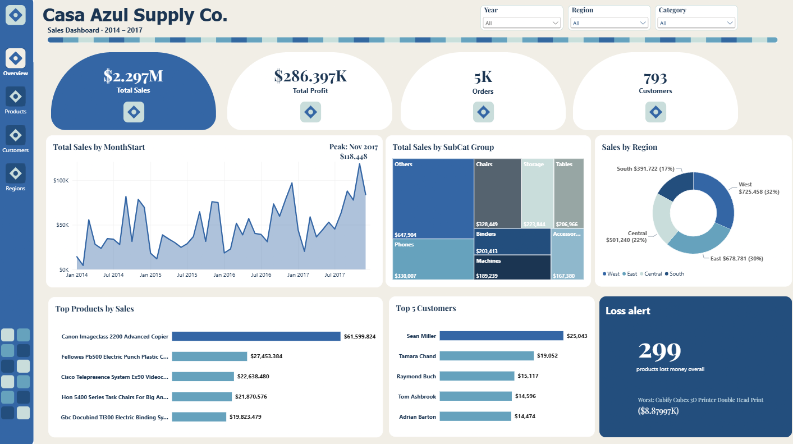
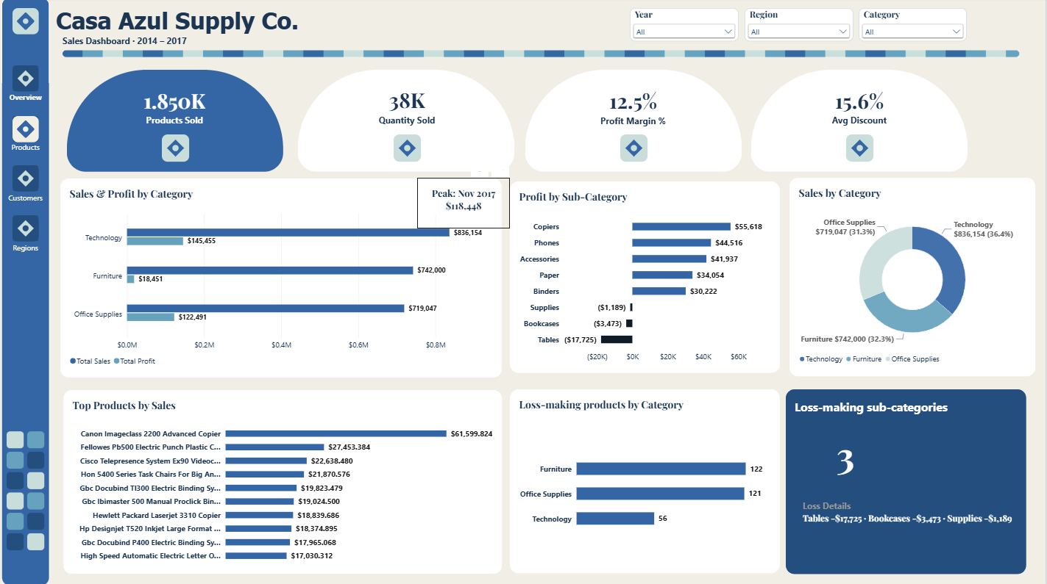

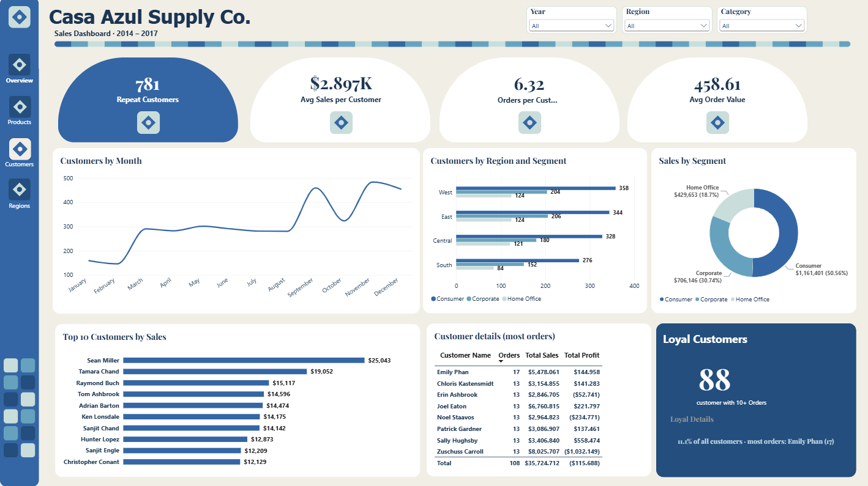
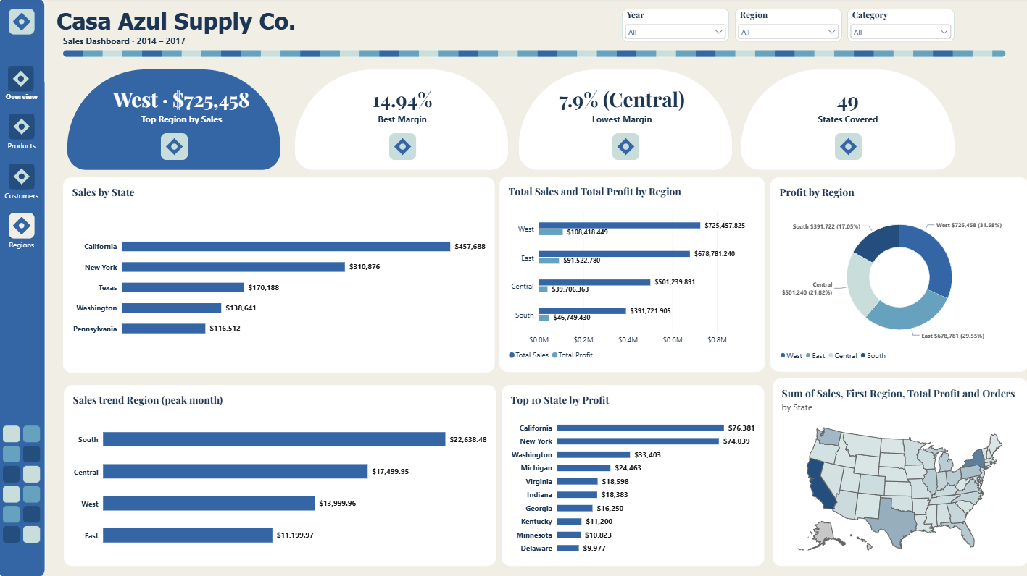
One dashboard, four pages
Overview
Products
How big is the business, and when does it peak?
What sells, what earns, what loses?
Customers
Regions
Who buys, who returns, who is loyal?
Where do we earn and where do we lose?
POWER BI DASHBOARD
Notes:
PRESENTER 2. Casa Azul identity: arch door landing page leads to Overview, Products, Customers, Regions. Year/Region/Category slicers are synced across pages.

Slide 16
Overview: a growing business with a clear peak
$2.297M sales
Total profit $286K on 5K orders from 793 customers: the page answers “how big are we?” at a glance.
Peak: Nov 2017
Monthly sales peak at $118,448. West ($725K, 32%) and East ($679K, 30%) bring in about 61% of sales.
299 loss-makers
Loss alert: 299 products lost money overall; worst is the Cubify CubeX 3D printer (−$8,880), the same item as in Q6.
POWER BI DASHBOARD
16
Notes:
PRESENTER 2. Overview KPIs, trend, treemap, region donut, top products/customers and loss alert.

Slide 17
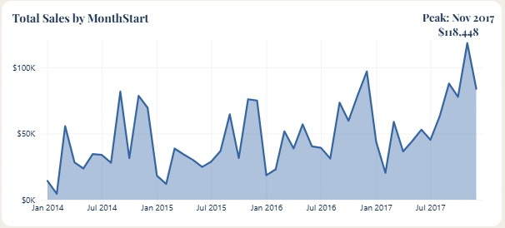
Overview: seasonality drives the sales line
Nov $352K · Dec $325K · Sep $308K
Strongest months when all four years are added together (verified on the data).
Feb $60K · Jan $95K
Weakest months pooled over 2014–2017.
Why it matters
Q4 spikes recur year after year, so campaigns and stock can be planned ahead; the cause of the spikes is not in the data.
POWER BI DASHBOARD
17
Notes:
PRESENTER 2. Pooled over four years, Nov, Dec and Sep are the strongest months; Feb is weakest. Data ends 30 Dec 2017 (see Q2).

Slide 18
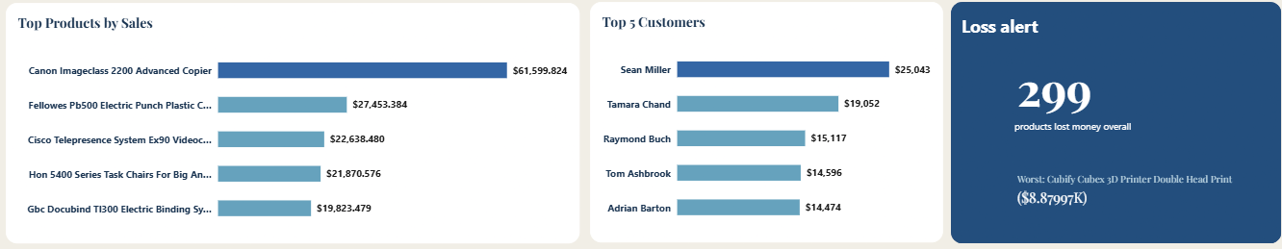
Overview: the same names that SQL found
Top products
Top 5 customers
Loss alert
The Canon imageCLASS 2200 copier leads at $61.6K, the same value as in Q3.
Sean Miller $25,043 and Tamara Chand $19,052 lead — identical to Q1.
299 products lost money; the worst is −$8,880 — Q6 lists the full ranking.
POWER BI DASHBOARD
18
Notes:
PRESENTER 2. Top products, top customers and loss alert show the same figures as Q3, Q1 and Q6.

Slide 19
Products: balanced sales, unbalanced profit
Sales ≈ equal
Technology $836K, Furniture $742K and Office Supplies $719K each take about a third of sales.
Margin 12.5%
Furniture earns only $18K profit on $742K sales; Technology earns $145K.
3 loss-makers
Tables −$17,725, Bookcases −$3,473 and Supplies −$1,189 lose money; 299 products overall.
POWER BI DASHBOARD
19
Notes:
PRESENTER 2. Products page: category sales vs profit, profit by sub-category, loss-making products by category.

Slide 20
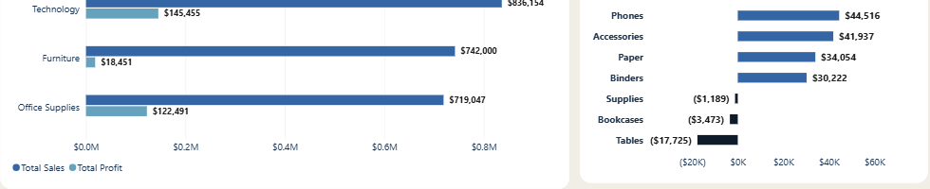
Products: where the profit actually comes from
Copiers $55.6K
Tables −$17.7K
122 / 121 / 56
Top profit sub-category, ahead of Phones $44.5K and Accessories $41.9K.
Biggest loss sub-category, despite $207K in sales.
Loss-making products: Furniture 122, Office Supplies 121, Technology 56.
POWER BI DASHBOARD
20
Notes:
PRESENTER 2. Furniture sells almost as much as Technology but earns a fraction. Tables, Bookcases and Supplies are the loss-making sub-categories.

Slide 21
Customers: loyal base, concentrated value
781 of 793 repeat
98.5% of customers bought more than once; they average 6.3 orders each.
88 loyal customers
11.1% of customers have 10+ orders; they bring 19.3% of sales (verified on the data).
Consumer 50.6%
Consumer $1.16M, Corporate $706K, Home Office $430K of sales.
POWER BI DASHBOARD
21
Notes:
PRESENTER 3 starts here. Customers page: repeat and loyal customers, segments, customers by region, top customers.

Slide 22
Regions: West leads, Central lags on margin
West $725K
Top region by sales with the best margin, 14.94%.
Central 7.9%
Lowest margin: $501K sales but $39.7K profit — less than South ($46.7K on $392K).
California & New York
Top states by profit: $76.4K and $74.0K; 49 states are covered.
POWER BI DASHBOARD
22
Notes:
PRESENTER 3. Regions page: sales vs profit by region, states, peak month, map.

Slide 23
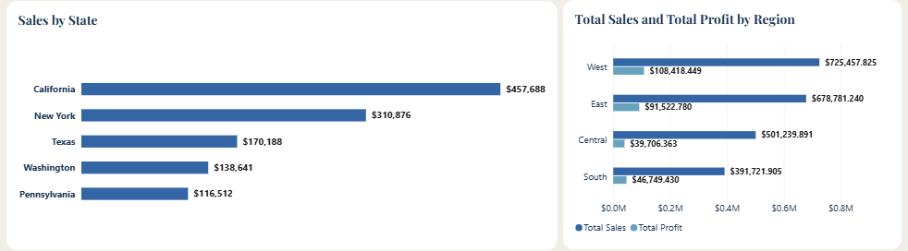
Regions: sales and profit tell different stories
Same sales rank ≠ same profit rank
Central sells more than South ($501K vs $392K) but earns less ($39.7K vs $46.7K).
Top 10 states by profit
California $76K and New York $74K, then Washington $33K — profit is concentrated in a few states.
A hint, not a proof
Sales by State (left), Total Sales and Total Profit by Region (centre), Profit by Region (right).
Central’s average discount is 24.0% vs 10.9% in West (see Insights).
POWER BI DASHBOARD
23
Notes:
PRESENTER 3. Compare the two bars per region; Central has the largest sales-to-profit gap.

Slide 24
Insight 1 · Growth with a Sep–Dec peak
Total sales by year ($)
EVIDENCE
Sales rose from $484K (2014) to $733K (2017), +51%; margin moved from 10.2% to 12.7% (2015 dipped −2.8%).
PATTERN
Each year builds toward Sep, Nov and Dec; Feb is the weakest month.
BUSINESS MEANING
Growth is real and recurring peaks are predictable.
IMPLICATION
Plan campaigns and stock for Sep–Dec; investigate why Q1 is weak.
BUSINESS INSIGHTS
Notes:
PRESENTER 3. Yearly figures verified on the data.

Slide 25
Insight 2 · Similar sales, very different profit
Sales vs profit by category ($)
EVIDENCE
Technology $836K sales / $145K profit (17.4%); Furniture $742K / $18K (2.5%); Office Supplies $719K / $122K (17.0%).
PATTERN
Furniture’s losses are concentrated: Tables −$17.7K and Bookcases −$3.5K.
BUSINESS MEANING
One third of revenue earns almost no profit.
IMPLICATION
Check pricing and discounts on Tables and Bookcases before growing Furniture.
BUSINESS INSIGHTS
Notes:
PRESENTER 3. Margins from total profit divided by total sales per category.

Slide 26
Insight 3 · Discounts above 20% mean losses
Profit margin by discount level (%)
EVIDENCE
0% discount: +29.5% margin; 11–20%: +11.6%; 21–30%: −10.0%; 31–50%: −24.8%; above 50%: −119.2%.
PATTERN
Margin falls steadily as the discount rises and turns negative above 20%.
BUSINESS MEANING
Discounted lines (from 21%) earn a loss: −$135K in total.
IMPLICATION
This may indicate discounts drive losses; further analysis would confirm causes (product mix, region).
BUSINESS INSIGHTS
Notes:
PRESENTER 3. Relationship observed in the data, not proven causation. 21%+ losses: −10,369 −48,448 −76,559 = −$135,376.

Slide 27
Insight 4 · Big sales are not always big profit
Profit of the 10 top-selling customers ($)
EVIDENCE
Sean Miller: #1 in sales ($25,043) but −$1,981 profit. Cisco TelePresence: #3 in sales, −$1,811 profit.
PATTERN
Across all customers, 155 have a negative total profit (−$71,224 combined).
BUSINESS MEANING
Sales rankings hide unprofitable accounts and products.
IMPLICATION
Track profit next to sales for customers and products.
BUSINESS INSIGHTS
Notes:
PRESENTER 3. Customers ordered by sales (Q1 order); bars show their total profit.

Slide 28
Insight 5 · Central: top discounts, low margin
Average discount vs profit margin by region (%)
EVIDENCE
Central: 24.0% avg discount, 7.9% margin. West: 10.9% and 14.9%.
PATTERN
Central’s losses sit in Texas (−$25.7K) and Illinois (−$12.6K); East has Ohio (−$17.0K) and Pennsylvania (−$15.6K).
BUSINESS MEANING
A discount gap may help explain the margin gap in Central.
IMPLICATION
Review discount practice in these states before changing prices.
BUSINESS INSIGHTS
Notes:
PRESENTER 3. Association only: the data does not prove that discounts caused the margin gap.

Slide 29
Act first: stop the profit leaks
1
Review discounts above 20%
2
Fix Furniture pricing
3
Review Central region discounts
EVIDENCE
EVIDENCE
EVIDENCE
Lines discounted 21%+ lose money (−$135K); above 50% margin is −119%.
Furniture margin 2.5%; Tables −$17.7K, Bookcases −$3.5K.
Central: 24.0% avg discount, 7.9% margin; Texas −$25.7K, Illinois −$12.6K.
ACTION
ACTION
ACTION
Set a discount ceiling or approval step for deep discounts, starting with Tables and Bookcases.
Investigate costs and discounts on Tables and Bookcases before choosing price or range changes.
Audit discount practice in Texas and Illinois; then check Ohio and Pennsylvania (East).
MEASURE (proposed)
MEASURE (proposed)
MEASURE (proposed)
Share of sales lines above 20% discount; margin of discounted lines.
Margin by sub-category after review.
Avg discount and margin in these states.
RECOMMENDATIONS
Notes:
PRESENTER 4 starts here. Evidence → action → how to measure. Metrics are proposed, not yet calculated.

Slide 30
Build next: grow where it pays
4
Prepare for Sep–Dec
5
Reward the 88 loyal customers
6
Track profit with sales
EVIDENCE
EVIDENCE
EVIDENCE
Nov $352K, Dec $325K, Sep $308K pooled; peak Nov 2017 $118K.
88 customers (11.1%) bring 19.3% of sales; 98.5% of customers repeat.
Sean Miller #1 in sales, −$1,981 profit; 155 customers have negative profit.
ACTION
ACTION
ACTION
Schedule campaigns and stock decisions ahead of the autumn peak; study why Feb–Jan are weak.
Create a loyalty programme for 10+ order customers; check low-profit loyal accounts first.
Add profit to customer and product rankings; investigate the 299 loss-making products.
MEASURE (proposed)
MEASURE (proposed)
MEASURE (proposed)
Sep–Dec sales vs prior year; Feb sales.
Orders per loyal customer; profit per loyal customer.
Number of loss-making products and customers.
RECOMMENDATIONS
Notes:
PRESENTER 4. Longer-term opportunities; no ROI or uplift is claimed.

Slide 31
From questions to decisions
SQL
Answered 10 questions: Technology leads sales ($836K), one copier earns $61.6K, 299 products lose money.
Power BI
Made the same data explorable: seasonality, category margins, customers and regions at a glance.
Insights
Sales grow but profit leaks through deep discounts, Furniture and Central.
Next steps
Cap discounts, fix Furniture pricing, audit Central, plan for Sep–Dec, reward loyal customers.
CONCLUSION
Notes:
PRESENTER 4. Summarize the journey.

Slide 32

Get the booklet on your phone
CASA AZUL SUPPLY CO. · SQL & POWER BI SALES ANALYTICS
Notes:
PRESENTER 4. Open for Q&A.

Slide 33




